Slide 1
Mushroom Classification
Joshua Hoshiko
Gerom Pagaduan
Dan Reuter

Slide 2
General Information
Focused on a variety of different classifiers to compare performance and analyzed the importance of individual features.
Utilized SVM, KNN, and Logistic Regression
Packages used:
  Sklearn: KNN, SVM, and Logistic Regression classifiers. For data preparation: label encoder, and train_test_split. For test results: classification_report, accuracy_score, and confusion_matrix
  Numpy: mostly for the use of numpy-arrays
  Pandas: almost all dataframe manipulation

Slide 3
Project Details
Mushroom dataset consists of 8124 mushrrom samples with 22 categorical features
Originally found on Kaggle at https://www.kaggle.com/uciml/mushroom-classification
The Mushrooms are classified into two categories: edible or poisonous. When a mushroom sample was not determined to be edible or poisonous, it was assumed to be poisonous

Slide 4
Mushroom Features
Large variety of features, each with sub classes for each feature
cap-shape, cap-surface, cap-color, bruises, odor, gill-attachment, gill-spacing, gill-size, gill-color, stalk-shape, stalk-root, stalk-surface-above-ring, stalk-surface-below-ring, stalk-color-above-ring, stalk-color-below-ring, veil-type, veil-color, ring-number, ring-type, spore-print-color, population, and habitat

Slide 5
Data preprocessing
Features had different categories within each column. For example, cap-shape has 6 different categories: bell=b, conical=c, convex=x, flat=f, knobbed=k, and sunken=s
In order to train a model using this data, we needed to preprocess the data into something easier to recognize by a computer

Slide 6
Data Preprocessing
Two different approaches:
  Teammates pursued changing all of the symbols to unique numerical representations. For example a=1, b=2, c=3
  I pursued an approach which utilizes dummy variables. What this means is each column is split into k-1 binary value columns where k is the number of categories inside that column. The binary values represent true/false for a specific subclass within a feature. The reason there are always k-1 new columns is because the last category is implied if all the others are false
  For example, the cap-shape mentioned before had 6 subclasses. When dummied, the column turns in to 5 new columns for each subclass
  Once dummied, the 22 feature columns turned into 95 new columns

Slide 7
Data preprocessing performance
Dummied data preformed significantly better than unique numerical values
However, the unique numerical representation approach was still sufficient for the classifiers to function, just not as efficiently

Slide 8
Training, testing, and results
The first half of the program tests different ratios of training/testing data. This was to strain the classifiers because their performance was extremely high with even small amount of training
For example, almost all of the classifiers accurately predicted the edibility of the mushrooms 100% of time. Even at 1% training and 99% testing, all of the models still tested above 90% accuracy
Although all of the all of the models preformed extremely well, at smaller sizes of training data, SVM preformed better with an accuracy score a few percent above the others

Slide 9
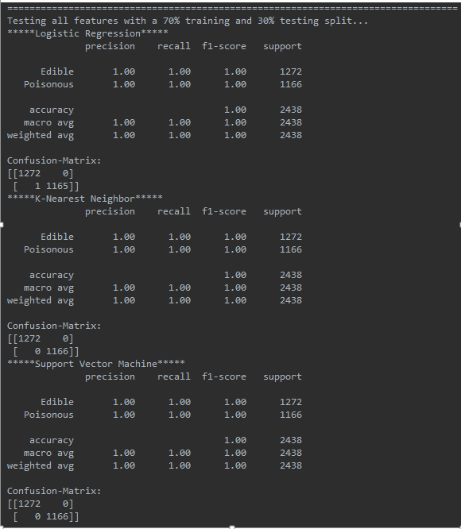
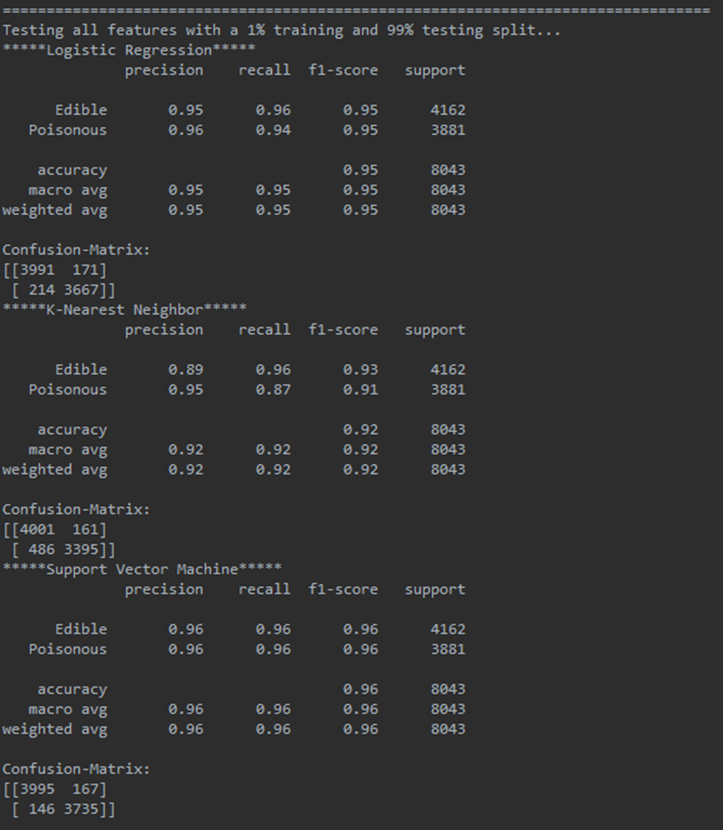
Training/testing ratio test results

Slide 10
Features Test
Because of the extremely high accuracy, I decided to test each feature individually to see it’s impact on the classifiers’ ability to predict edibility
My hypothesis was that either the amount of features or a few specific features heavily contributed to the success of all three models
Each of the features split into its own data-frame and tested on with all three classifiers (SVM, Logistic Regression, KNN) with a 70% training and 30% testing split

Slide 11
Features test results
Comparing accuracy scores, the three highest scoring features are Odor, spore-print color, and gill color
Amazingly, even with just odor, the model was able to accurately predict 98% of the samples, with spore-print color following at 88% accuracy, and fill-color at 80%

Slide 13
Features test results
1. odor, average accuracy: 0.9865 | 12. habitat, average accuracy: 0.6932
2. spore-print-color, average accuracy: 0.8819 | 13. stalk-root, average accuracy: 0.6468
3. gill-color, average accuracy: 0.8076 | 14. gill-spacing, average accuracy: 0.6079
4. ring-type, average accuracy: 0.7904 | 15. cap-color, average accuracy: 0.6001
5. stalk-surface-above-ring, average accuracy: 0.7797 | 16. cap-surface, average accuracy: 0.5726
6. stalk-surface-below-ring, average accuracy: 0.774 | 17. cap-shape, average accuracy: 0.5722
7. gill-size, average accuracy: 0.7506 | 18. stalk-shape, average accuracy: 0.5455
8. bruises, average accuracy: 0.7482 | 19. ring-number, average accuracy: 0.5304
9. population, average accuracy: 0.7281 | 20. veil-color, average accuracy: 0.5226
10. stalk-color-above-ring, average accuracy: 0.726 | 21. gill-attachment, average accuracy: 0.5217
11. stalk-color-below-ring, average accuracy: 0.7223 | 22. veil-type, average accuracy: NONE, not tested because it has only one category

Slide 14
Thank you for a fantastic semester!!

